Slide 1
Lec - 5

Slide 2

TYPE - B
PROBLEMS BASED ON THE
FORMULA
h₁
Object height
h₂
Image height
h₂
-v
M =
=
h₁
u
u
Object distance
v
Image distance

Slide 3

HOW TO READ MAGNIFICATION
M = + 1
M = - 0.5
+ : erect (Virtual)
= 1 : same size
- : inverted (Real)
- : inverted (Real)
>1 : magnified
<1 : diminished
<1 : diminished

Slide 4

1
The magnification produced by a plane mirror is +1. What does this mean ?
Solution :
Erect, Virtual and same size
2
What is the nature of the image formed by a concave mirror if the magnification produced by the mirror is +3 ?
Solution :
Erect, Virtual and Magnified
3
What is the nature of the image formed by a concave mirror if the magnification produced by the mirror is, – 0.75 ?
Solution :
Inverted, Real and Diminished

Slide 5

Light – Reflection and Refraction
Type B Numericals 1 and 2

Slide 6
An object 4 cm in height is placed at a distance of 36 cm from a concave mirror. The image is formed 18 cm in front of the mirror. Find the height of the image.
1
Given :
Object height (h₁)
= 4 cm
Object distance (u)
= - 36 cm
To Find :
Image distance (v)
= - 18 cm
Formula :
Height of image (h₂)
= ?
A
4 cm
B^{I}
h₂
-v
Solution :
M =
=
u
B
C
F
P
h₁
2
v × h₁
4
?
36 cm
h₂
=
-
∴
h₂
=
-
18 cm
u
2
A^{I}
1
1
-18 × 4
∴
h₂
=
-
The height of the image is 2 cm and it is real and inverted.
-36
∴ h₂ = -2 cm
2

Slide 7
2
A converging mirror forms a real image of height 4 cm of an
object of height 1 cm placed 20 cm away from the mirror. Find the image distance.
Given :
Height of image (h₂)
= -4 cm
A
B^{I}
1 cm
20 cm
Object height (h₁)
= 1 cm
C
B
F
P
Object distance (u)
= -20 cm
4 cm
A^{I}
To Find :
Image distance (v)
= ?
?
Formula :
h₂
-v
-20 × -4
M =
=
∴
v
=
-
h₁
u
1
u × h₂
- 80
Solution :
-v
=
∴
v
=
∴ v = -80 cm
h₁
1
u × h₂
The image distance is 80 cm and is in front of the mirror.
∴
-v
=
h₁

Slide 8

(a) A concave mirror produces three times enlarged image of an object placed at 10 cm in front of it. Calculate the focal length of the mirror.
(b) Show the formation of the image with the help of a ray diagram when object is placed 6 cm away from the pole of a convex mirror.
*3
Ans.
(a) u = - 10 cm
-v
m =
= -3
(–ve sign as image is formed in front of the mirror.)
u
v
= 3
(b)
u
A
v = 3 u or v = 3 × – 10 = – 30 cm
B^{I}
1
1
1
B
+
=
C
F
P
v
u
f
6 cm
-
1
-
1
1
=
∴ f = -7.5 cm
A^{I}
30
10
f

Slide 9
An object 10 cm in height is placed at a distance of 36 cm from a concave mirror. If the image is formed 18 cm in front of the mirror. Find the height of the image.
4
Given :
Object height (h₁)
= 10 cm
A
Object distance (u)
= - 36 cm
Image distance (v)
= - 18 cm
10 cm
B^{I}
To Find :
Height of image (h₂)
= ?
B
C
F
P
h₂
-v
?
36 cm
Formula :
M =
=
h₁
u
18 cm
A^{I}
v × h₁
5
Solution :
h₂
=
-
10
u
∴
h₂
=
-
∴ h₂ = -5 cm
2
1
-18 × 10
1
∴
h₂
=
-
-36
The height of the image is 5 cm and it is inverted.
2

Slide 10
An object 2cm high is placed at a distance of 16 cm from a concave mirror which produces a real image 3 cm high. Find the image distance.
5
Given :
Object height (h₁)
= 2 cm
Object distance (u)
= - 16 cm
Height of image (h₂)
= - 3 cm
To Find :
Image distance (v)
= ?
A
h₂
-v
B^{I}
2 cm
Formula :
M =
=
u
B
C
F
P
h₁
3 cm
16 cm
u × h₂
A^{I}
Solution :
-v
=
?
h₁
8
-16 × -3
u × h₂
∴
v
=
-
-v
=
-
2
h₁
1
The image is formed at a distance of 24 cm in front of mirror.
∴ v = -24 cm

Slide 11
Light – Reflection and Refraction
Type B Numericals 3 and 4

Slide 12
6
For a convex mirror the object distance u = 30 cm to the left,
image distance v = 12 cm to the right of the mirror and height of object = 5 cm. Find the height of image.
∴ h₂ = 2 cm
The height of the image is 2 cm and it is erect.
7
A concave mirror produces three times magnified (enlarged) real image of an object placed at 10 cm in front of it. Where is the image located ?
∴ v = -30 cm
The image distance is 30 cm and is in front of the mirror.

Slide 13

For a convex mirror the object distance u = 30 cm to the left,
image distance v = 12 cm to the right of the mirror and height of object = 5 cm. Find the height of image.
6
A
A^{I}
Given :
Object distance (u)
= -30 cm
5 cm
?
Image distance (v)
= 12 cm
12 cm
B
P
B^{I}
F
C
Image height (h₁)
= 5 cm
30 cm
To Find :
Height of image (h₂)
= ?
12 × 5
∴
h₂
=
-
h₂
-v
-30
Formula :
M =
=
h₁
u
2
-60
∴
h₂
=
∴ h₂ = 2 cm
h₂
-v
-30
Solution :
=
1
h₁
u
v × h₁
Ans: The height of the image is 2 cm and it is erect.
h₂
=
-
u

Slide 14
A concave mirror produces three times magnified (enlarged) real image of an object placed at 10 cm in front of it. Where is the image located ?
7
Solution :
Given :
Magnification (M)
= -3
A
B^{I}
10 cm
Object distance (u)
= -10 cm
C
B
F
P
To Find :
Image distance (v)
= ?
3
?
-v
A^{I}
Formula :
M =
u
∴
v
=
- 30
Solution :
-v
M =
u
∴ v = -30 cm
-v
M × u
=
Ans: The image distance is 30 cm and is in front of the mirror.
∴
-v
=
-3 × -10

Slide 15
Light – Reflection and Refraction
Type C Numericals - 1

Slide 16
TYPE - C
PROBLEMS BASED ON THE
FORMULA
1
1
1
v
+
u
=
f
h₂
v
M =
= -
h₁
u

Slide 17
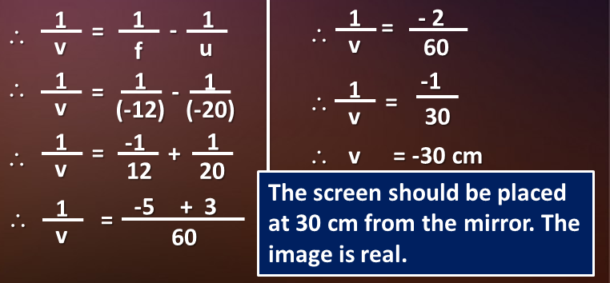

An object 3cm in size, is placed at 20 cm in front of a concave mirror of focal length 12cm. At what distance from the mirror should a screen be placed in order to obtain a sharp image. Also find the nature and size of the image.
1
A
Given :
Object height (h₁)
= 3 cm
B^{I}
3 cm
12 cm
Object distance (u)
= -20 cm
C
B
F
P
?
Focal length (f)
= -12 cm
A^{I}
20 cm
To Find :
Image distance (v)
= ?
?
h₂
- v
1
- 2
Image Size (h₂)
= ?
1
1
1
=
M =
=
∴
=
-
∴
v
f
u
h₁
u
v
60
1
1
1
Formulae :
+
=
1
1
1
v × h₁
-1
v
u
f
∴
=
∴
-
1
h₂
-
v
(-12)
=
∴
=
h₂
(-20)
u
v
30
-v
M =
=
1
-1
1
3
u
∴
=
+
∴
v
=
-30 cm
h₁
v
12
(- 30) × (3)
20
=
∴ h₂ = - 4.5 cm
1
1
1
∴
h₂
-
The screen should be placed at 30 cm from the mirror. The image is real.
Solution :
+
=
1
-5
+
3
- 20
v
u
f
∴
=
2
v
Height of the image is 4.5 cm. It is an inverted and enlarged image.
60

Slide 18
An object of size 7.0 cm is placed at a distance of 27 cm in front of a concave mirror of focal length 18 cm. At what distance from the mirror should a screen be placed so that a sharp image can be obtained? Find the size and nature of image.
*2
Ans.
h₁ = 7 cm, u = –27 cm, f = – 18 cm
using mirror formula,
The image is formed 54 cm in front of the mirror. Thus, the screen should be held 54 cm in front of the mirror.
1
1
1
+
=
v
u
f
1
1
1
h₂
- v
∴
=
-
m =
=
v
f
u
h₁
u
=
1
-
1
v × h₁
∴
h₂ =
-
-18
-27
u
=
1
+
1
(-54) × 7
-
1
-1
∴
h₂ =
-
18
27
∴
=
-27
v
54
-3 + 2
∴ The image is real, inverted and magnified (h₂ > h₁).
=
54
∴ v = -54 cm
∴ h₂ = -14 cm

Slide 19
An object, 4cm in size, is placed at 25cm in front of a concave mirror of focal length 15cm. At what distance from the mirror should a screen be placed in order to obtain a sharp image?
Find the nature and the size of the image.
3
A
4 cm
15 cm
B^{I}
Given :
Object size
h = + 4cm
B
C
F
P
Object distance
u = - 25cm
25 cm
Focal length,
f = - 15cm
To Find :
Image distance
v = ?
25 - 15
10
Image size,
h₂ = ?
=
=
∴ v = -37.5 m
-15 × 25
-375
Formula :
1
1
1
The screen should be placed at 37.5 cm from the mirror. The image is real.
+
=
v
u
f
1
1
1
h₂
v
vh₁
Solution :
∴
=
–
M =
= -
h₂ = -
v
f
u
h₁
u
u
1
1
(-37.5) × 4
150
–
=
–
= -
= - 6 cm
– 15
– 25
(-25)
25
1
1
Image distance is 37.5 cm and height of the image is 6 cm, Thus image is enlarged and inverted
=
+
-15
25

Slide 20
Light – Reflection and Refraction
Type C Numericals - 2

Slide 21
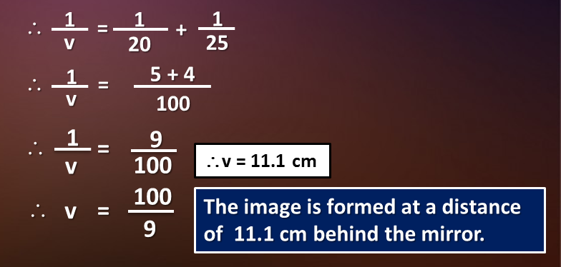
4
An arrow 2.5 cm height is placed at a distance of 25 cm from a diverging mirror of focal length 20 cm. Find the nature position and size of the image formed.
Given :
Object height (h₁)
= 2.5 cm
A
A^{I}
Object distance (u)
= -25 cm
2.5 cm
25 cm
?
Focal length (f)
= 20 cm
B
P
B^{I}
F
C
?
To Find :
Image distance (v)
= ?
20 cm
Image Size (h₂)
= ?
Formulae :
1
1
1
h₂
111 × 25
+
=
1
1
- v
1
∴
h₂ =
-
M =
=
v
u
f
∴
=
+
v
h₁
u
25
-25 × 10 × 10
20
h₂
-v
v × h₁
M =
=
∴
1
5 + 4
111
h₂
-
u
∴
=
=
h₁
v
u
∴
h₂ =
-
100
-100
Solution :
1
1
1
+
=
1
11.1 × 2.5
v
u
f
∴
h₂
9
∴
=
-
=
111
∴
h₂
=
100
∴v = 11.1 cm
1
1
1
v
- 25
100
∴
=
-
100
v
f
u
11.1 × 2.5 × 10 × 10
The image is formed at a distance of 11.1 cm behind the mirror.
∴
Height of the image is 1.11 cm. It is a virtual, erect and diminished image.
∴
v
=
1
1
1
h₂ =
-
∴
=
-
9
∴ h₂ = - 1.11 cm
v
-25 × 10 × 10
20
(-25)

Slide 22
A convex mirror used for rear-view on an automobile has a
radius of curvature of 3 m. If a bus is located at 5 m from this mirror, find the position, nature and size of the image.
*5
Given :
Radius of curvature
R = 3 m
A
Object distance
u = 5 m
A^{I}
To Find :
Image distance
v = ?
Height of the image
h₂ = ?
B
P
B^{I}
F
C
Formula :
1
1
1
Bus distance = 5m
Radius = 3m
+
=
v
u
f
Solution :
R
3 m
f
=
=
=
1.5m
7.5
2
2
=
∴ v = 1.15 m
6.5
1
1
1
1
1
1
The image is 1.15 m at the back of the mirror.
∴
+
=
∴
=
‒
v
u
f
v
f
u
h₂
v
1.15m
M =
= ‒
= ‒
= +0.23
1
1
1
1
5 + 1.5
h₁
u
-5.00m
=
1.5
‒
(-5)
=
+
=
1.5
5
7.5
The image distance is 1.15 m and it is virtual, erect and smaller in size by a factor of 0.23

Slide 23
Thank You

